Slide 1


Presentation for A2
Han Chien Leow (s3778722)

Slide 2
Goal of the project
Satisfy the aim of this project, which is
to identify subsets of proteins that are discriminant between the classes
Research the best data model possible with the approach of classification
supervised machine learning technique
Notes:
Our goal is set to clearly satisfy the aim of this project, which is to identify subsets of proteins that are discriminant between the classes and research the best data model possible with the approach of classification for this particular project using supervised machine learning techniques

Slide 3
Description of data set
Values of expression levels for 77 proteins
Genotype: control (c) or trisomy (t)
Treatment type: memantine (m) or saline (s)
Behavior: context-shock (CS) or shock-context (SC)
Class: c-CS-s, c-CS-m, c-SC-s, c-SC-m, t-CS-s, t-CS-m, t-SC-s, t-SC-m
Notes:
The data set consist of 77 proteins with the value of expression levels, genotype of either control or trisomy, treatment type of memantine or saline, behavior of context shock or shock context as well as different classes based on the genotype, treatment and behavior,

Slide 4
Data preparation steps.
Check data types
.dtypes function
Typos
.value_counts() function
Extra-whitespaces
.value_counts() function
Upper/Lower-case
.value_counts() function
Sanity checks
a simple for loop was developed to check if there are overly high values (>10) and negative values (<0) of expression levels for all theproteins.
Missing values
.isna().sum()
missing values (NaN) were filled with the mean
Notes:
The data types were checked using the .dtypes function which shows the data types for all of the columns present in the mice protein expression data frame
The typos, extra-whitespaces, upper and lower case were checked using the .value_counts function that shows a frequency table.
Sanity check was executed as well using a for loop to check for illogical values
furthermore, the missing values was check using the .isna()sum() function and were filled with the mean.

Slide 5
Hypotheses/questions that you were investigating.
The values of expression levels for all the first 10 proteins were explored using a box plot.
DYRK1A_N
ITSN1_N
BDNF_N
NR1_N
NR2A_N
pAKT_N
pBRAF_N
pCAMKII_N
pCREB_N
pELK_N
The box plot shows the median, upper and lower quartile as well as the outliers for each proteins
Notes:
The values of expression levels for the first 10 proteins were explored using a box plot. The box plot is extremely insightful because it shows the median, upper and lower quartile as well as the outliers for each proteins.

Slide 6
Hypotheses/questions that you were investigating.
Relationships between values of expression levels on different proteins by genotype, treatment, behavior and class.
Side-by-side box plot
Hypothesis is accepted or rejected
Notes:
After that, the relationships between values of expressiion levels on different proteins by genotype, treament behavior and class were explored using a side-by-side box plot. The hypothesis is accepted or rejected after the analysis of graph.

Slide 7
Data Modeling
Generating Train/Test Set
The X target of all the protein columns and y target of the class column are set in this process.
The train and test set are generated as X_train, X_test, y_train and y_test using sklearn train_test_split() method, where the test size is set to 40%.

Slide 8
Data Modeling
Feature Selection
executed using Hill Climbing Technique
37 features are shown as our important proteins with their indexes provided by the algorithm

Slide 9
Data Modeling
K-Nearest Neighbors Classification
Using default value
using all proteins
using only important proteins
Notes:
After that, the kNN classification is excecuted using default value by training using all proteins and using only the important proteins to get a fair comparison.

Slide 10
Data Modeling
Parameter Tuning
weights parameter set to 'distance'
p value to 1.
n_neighbors to 3
Recommendation
parameters of n_neighbors set as 3, weights as 'distance', ‘p’ value as 1 using feature selected proteins for kNN classification.
Notes:
Parameter tuning is executed step by step with the weight parameter set to distance, p value to 1 and n_neighbors to 3 to observe the improved result.
My recommendation will be setting the parameter of n neighbors as 3, weight as distance, p value as 1 using only the selected prroteins for this kNN classification

Slide 11
Data Modeling
Decision tree classification
Using default value
using all proteins
using only important proteins
Notes:
In addition, decision tree classification will be excecuted using the default value by training using all proteins and only important proteins to get a fair comparison.

Slide 12
Data Modeling
Parameter Tuning
class_weight parameter set to 'balanced'
gini to ‘entropy’
Recommendatioon
parameters of class_weight set as 'balanced' and criterion as 'entropy' without using the feature selected proteins for decision tree classification.
Notes:
Parameter tuning is executed step by step with the class weight parameter set to balance, gini to entropy to observe the improved result.
My recommendation will be setting the parameters of class_weight set as 'balanced' and criterion as 'entropy' without using the feature selected proteins for decision tree classification.

Slide 13
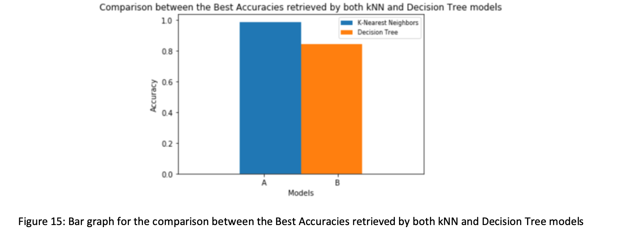
Conclusion & final recommendation
kNN model with the parameters of n_neighbors set as 3, weights as 'distance', ‘p’ value as 1 trained using only important proteins will be my recommendation to identify subsets of proteins that are discriminant between the classes.

